Slide 1
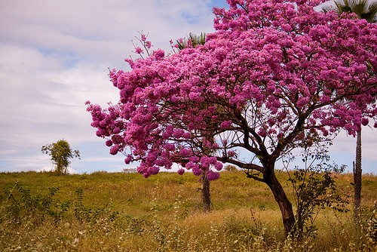
History of Pharmacognosy

Slide 2
INTRODUCTION
The term “Pharmacognosy” is derived from two Greek words:
“Pharmakon" meaning - drug or medicine
“Gnosis" meaning - To acquire knowledge.
Coined by : C.A. Seydler ( 1815) – In his doctoral thesis entitled Analectica Pharmacognostica.
J.A Schmidt (1811)- Lehrbuch der materia medica
Pharmacognosy is the study of the physical, chemical, biochemical and biological properties of drugs of natural origin

Slide 3
Origin of pharmacognosy
History of herbal medicines is a old as human civilization.
Primitive man in his search for food ate at random, if no harmful effects were observed, he considered them edible, if any effects were observed considered them inedible, and according to their actions used them in treating symptoms or diseases.
Eg: If plant caused
Diarrhoea - used as purgative
Vomiting – used as emetic
Poisonous – used as arrow poison.
Thus the knowledge was emperical and obtained by trial and error, it was passed to the next generations and new information was added to it.
Pharmacognosy in its totality is not the work of just one or two continental areas but the overall outcome of the steadfast work of many of the bygone civilizations like Chinese, Indian, Egyptian, Persian, Babylonian.. and many more

Slide 4
Ancient India
Medicinal properties of plants were described in Rigveda and Atharvanaveda (3500- 1500 B.C) from which Ayurveda has developed.
Ayurvedic writings include:
Charaka samhitha: 50 groups of ten herbs
Sushrutha samhitha: 760 herbs in 7 sets
Astanga hrdayam samhitha
Sarngadhara samhitha
Bhava Prakasa samhitha
Madhava Nidananam samhitha

Slide 5
Ancient Greece and Rome
Hippocrates (460 - 360. B.C.) He was Greek scientist. He worked on human anatomy & Physiology . He prepared famous oath for physicians, which is still taken by the physicians. He is known as father of medicine.
Aristotle: (384-322 B.C) – a student of Plato, was a philosopher and is known for his writings on animal kingdom.
Theophrastus : (370-287 B.C) – a student of Aristotle wrote about plant kingdom.
Dioscorides: ( first century A.D) - a physician who described use of medicinal plants like belladona, ergot, opium, colchicum etc.
Galen: - (131 – 200 A.D) Galen was Greek pharmacist; he worked on extraction of chemical constituent from the plants. He developed various methods of extraction therefore the branch of pharmacy which deals with extraction of chemical constituent from plants & animals is called as Galenical Pharmacy.

Slide 6
ANCIENT EGYPT
The existing medical documents are
The Kahun medical papyrus ( 1900 B.C): It is the oldest and deals with the health of women, including birthing instructions.
Edwin smith papyrus ( 1600 B.C): Contains surgical instructions and formulas for cosmetics.
Ebers papyrus (1500 B.C) : Contains collection of 800 prescriptions mentioning 700 drugs.

Slide 7
Ancient china
Chinese pharmacy stems from Shen Nung ( 2700 B.C) – an Emperor who investigated the medicinal values of several hundreds of herbs and has written Pen-T- Sao, or native herbal consisting of 365 drugs which were subdivided as follows:
Emperor herbs – 120: used as food are non toxic
Minister herbs- 120: some are mildly toxic and some are not, have stronger therapeutic potential.
Servent herbs – 125: Have specific action to treat the disease and eliminate stagnation. Most of these are toxic and should not be used for prolonged periods.
The clinical manuals of chinese medicine are the basis for chinese and japanese herbalism called Kampo
Shan Hang Lun ( Treatise on the treatment of acute diseases caused by cold).
Chin Kuei Yao Leuh ( prescriptions from the golden chamber)

Slide 8
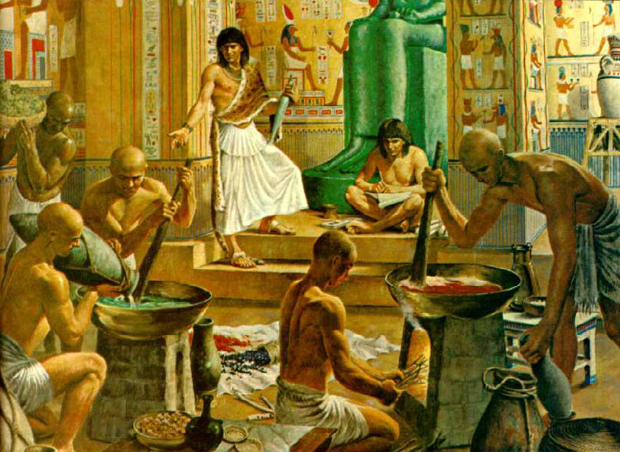
Egyptians (Ebers papyrus, 1550 BC)

Slide 9
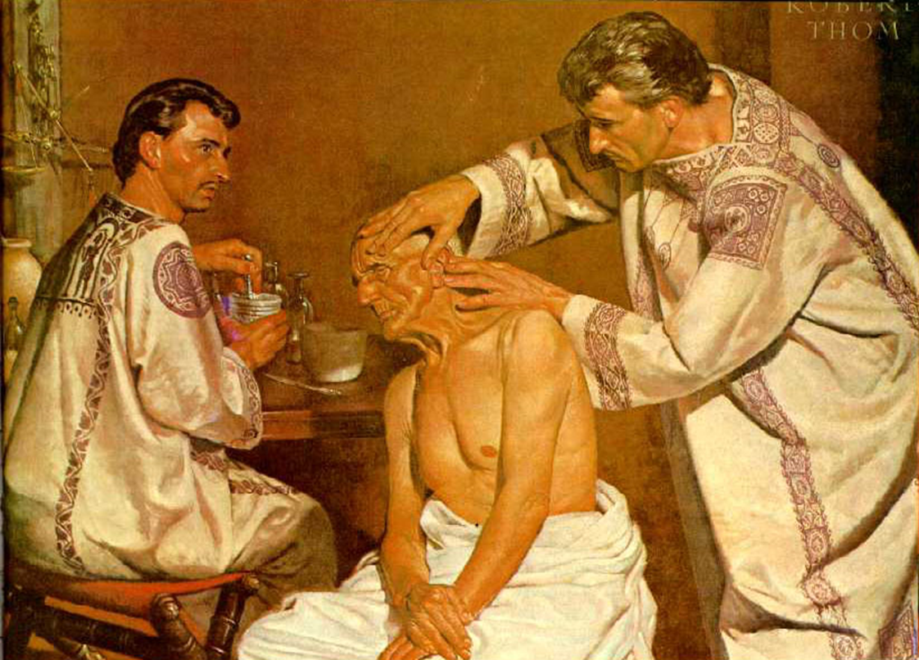
Hippocrates (460-377 BC)“The Father of Medicine”

Slide 10
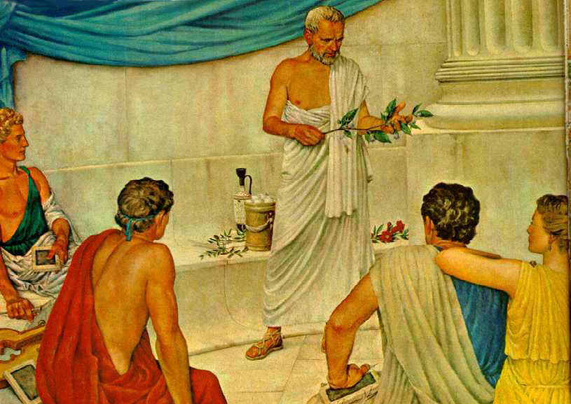
Dioscorides (40-80 AD) “De Materia Medica” (600 medicinal plants)

Slide 11
Modern Pharmacognosy
Development of modern Pharmacognosy took place during the period of 1934-1960, it was mainly due to:
Isolation of penicillin by william flemming and its large sclae production.
Isolation of reserpine from rauwolfia roots and confirming its hypotensive and tranquillizing properties.
Isolation of vinca alkaloids, vincristine and vinblastine which were found to be useful in treatment of leukemia.
Steroid hormones like progesterone were isolated and partially synthesized from diosgenin.

Slide 12
Isolation Or Analysis Of Phytochemicals :
Eg ; Strong acting substances such as glycosides from digitalis leaves
Alkaloids from the plants of Belladonna, Hyocyamus, Rauwlofia
Morphine and other alkaloids from the plant opium were isolated and clinical uses studied
Structure Activity Relationship :
Eg : Tubocurarine and Toxiferine from curare plant have muscle relaxant properties because of quaternary ammonium groups.
The hypotensive and tranquillizing actions of reserpine are due to the trimethoxy benzoic acid
Drugs Obtained By Partial Synthesis Of Natural Products:
Eg : Preparation of Steroid hormones from diosgenin by acetolysis and oxidation and further preparation of cortisone by microbial reactions
Natural Products As Models For Synthesis Of New Drugs :
Eg: Morphine is the model of a large group of potent drugs . Cocaine for local anaesthetics Atropine for certain spasmolytics

Slide 13
5. Drugs Of Direct Therapeutic Uses :
Among the natural constituents which even now cannot be replaced are important group of antibiotics, steroids, ergot alkaloids, vincristine etc
6. Biosynthetic Pathways Investigation :
Some of the important pathways are Clavin ‘s cycle of photosynthesis, Shikimic acid pathway of aromatic compounds, Acetate hypothesis for antharacene glycosides.
7. Use Of Natural Produts As Technical Products And Pharmaceutical Aids:
Technical products: Cinnamon oil and Peppermint oil- flavouring agents.
Pharmaceutical aids: acacia, tragacanth, guar gum, gelatin, bees wax.

Slide 14
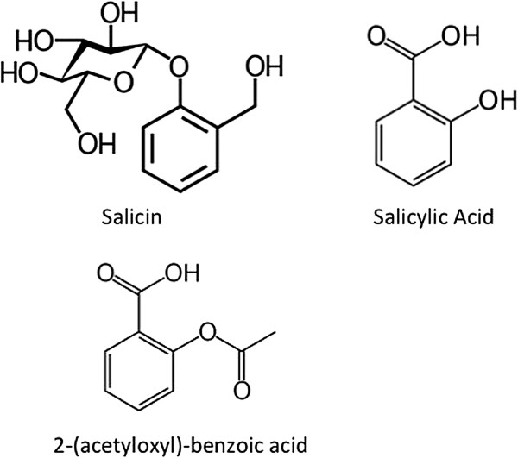
Story of Aspirin
400 BC In Greece Hippocrates gave women willow leaf tea to relieve the pain of childbirth.
1763 Reverend Edward Stone of Chipping Norton near Oxford gives dried willow bark to 50 parishioners suffering rheumatic fever. Describes his findings in a letter to the Royal Society of London.
1823 In Italy the active ingredient is extracted from willow and named salicin.
1838 Salicin also found in the meadowsweet flower by Swiss and German researchers.
1853 Salicylic acid made from salicin by French scientists but it is found to irritate the gut.
1893 German scientists find that adding an acetyl group to salicylic acid reduces its irritant properties.

Slide 15
1897 In Germany, Bayer’s Felix Hoffmann develops and patents a process for synthesizing acetyl salicylic acid or aspirin. First clinical trials begin.
1899 Clinical trials are successfully completed. aspirin launched.
1914 International trade in pharmaceuticals interrupted by the outbreak of World War I. Australian pharmacist G. R. Nicholas wins a competition to find a new way of producing aspirin.
1930s Bayer’s patent on acetyl salicylic acid runs out. It becomes a generic drug.
1974 First evidence of aspirin’s effects in preventing heart attacks: Professor Elwood.
1982 English scientist Professor Sir John Vane and two Swedish colleagues, Sune Bergström and Bengt Samuelsson win Nobel prize for discovering the role of aspirin in inhibiting prostaglandin production.
1989 US researchers report preliminary study suggesting that aspirin may delay the onset of senile dementia 1994 – Professor Henk C S Wallenburg of Rotterdam shows that aspirin may help in treating pre-eclampsia in pregnant women.
1995 American researchers find evidence that aspirin protects against bowel cancer.

Slide 16
1997 aspirin is now used or being tested for use in the following conditions:-
Heart attacks
Pregnancy Complication
Colon cancer
Diabetes
Dementia

